Slide 1
Subqueries
C393: Database Systems

Slide 2
Review

Slide 3
Lesson Objectives
Utilize subqueries to create more complex queries

Slide 4
Subqueries
SELECT cNum, firstName, lastName
FROM Cadet AS c
INNER JOIN CadetAccount AS a
ON c.cNum = a.owner
WHERE
a.balance = (
SELECT max(balance)
FROM CadetAccount
);
- Can utilize a query inside of another query. Useful in the WHERE or FROM clauses.
SELECT classNum, MAX(classNum)
FROM (
SELECT term, classNum, COUNT(*)
FROM Enrollment
GROUP BY term, classNum
)
GROUP BY classNum

Slide 5
WHERE subqueries
SELECT
FROM
WHERE [columnName]
( IN (subquery)
| operator ANY (subquery)
| operator ALL (subquery)
| operator (subquery)
)

Slide 6
Examples
SELECT *
FROM Enrollment AS e
INNER JOIN Cadet AS c
ON c.cNum = e.cNum
WHERE c.company = ‘B’
SELECT *
FROM Enrollment
WHERE cNum IN (
SELECT cNum
FROM Cadet
WHERE company = ‘B’
);

Slide 7
Examples
SELECT *
FROM CadetAccount
WHERE balance = (
SELECT MIN(balance)
FROM CadetAccount
);
SELECT *
FROM CadetAccount
WHERE balance <= ALL (
SELECT balance
FROM CadetAccount
);

Slide 8
Examples
SELECT *
FROM CadetAccount
WHERE balance < (
SELECT MAX(balance)
FROM CadetAccount
);
SELECT *
FROM CadetAccount
WHERE balance < ANY (
SELECT balance
FROM CadetAccount
);

Slide 9
WHERE subqueries
Typically used to help breakdown the query into multiple steps
Allows the query to “self-update” because the subquery will always run before the outer query
Can be useful to skip certain joins
Same concept applies to HAVING

Slide 10
FROM subqueries
SELECT
FROM (subquery) AS tableName
SELECT
FROM tableName
[INNER | LEFT | RIGHT] JOIN (subquery) AS tableName

Slide 11
Examples
SELECT *
FROM Enrollment AS e
INNER JOIN (
SELECT cNum
FROM Cadet
WHERE company = ‘B’) AS ij
ON e.cNum = ij.cNum;

Slide 12
Examples
SELECT MAX(sumBalance), AVG(sumBalance)
FROM (
SELECT SUM(balance) AS sumBalance
FROM CadetAccount
GROUP BY owner
) AS newTable;

Slide 13
Examples
SELECT MAX(sumBalance), AVG(sumBalance)
FROM (
SELECT SUM(balance) AS sumBalance
FROM CadetAccount
GROUP BY owner
) AS newTable;

Slide 14
Examples
SELECT MAX(newTable.sumBalance), AVG(newTable.sumBalance)
FROM (
SELECT SUM(balance) AS sumBalance
FROM CadetAccount
GROUP BY owner
) AS newTable;

Slide 15
Examples
SELECT AVG(classLoad)
FROM (
SELECT COUNT(*) AS classLoad
FROM Enrollment
WHERE term = ‘251’
) AS enrollmentCount;

Slide 16
Examples
SELECT *
FROM CadetAccount, (
SELECT AVG(totalBalance) AS avgBalance
FROM (
SELECT SUM(balance) AS totalBalance
FROM CadetAccount
GROUP BY owner
) AS a
) AS b
WHERE balance >= avgBalance;

Slide 17
FROM subqueries
Usually used if you want to
aggregate an aggregate
join on an aggregate

Slide 18
So What’s the Point?
Subqueries can make queries easier to read
You might have a query that already solves one problem
You can test the subquery independently of the other query
There may be performance considerations
We’ll talk about stored procedures later in the course

Slide 19
Writing Subqueries
SELECT SUM(balance) AS totalBalance
FROM CadetAccount
GROUP BY owner
SELECT *
FROM CadetAccount, (
WHERE balance >= avgBalance;
SELECT AVG(totalBalance) AS avgBalance
FROM (
)
)
Notes:
Which accounts have more than the networth of your average Cadet?

Slide 20
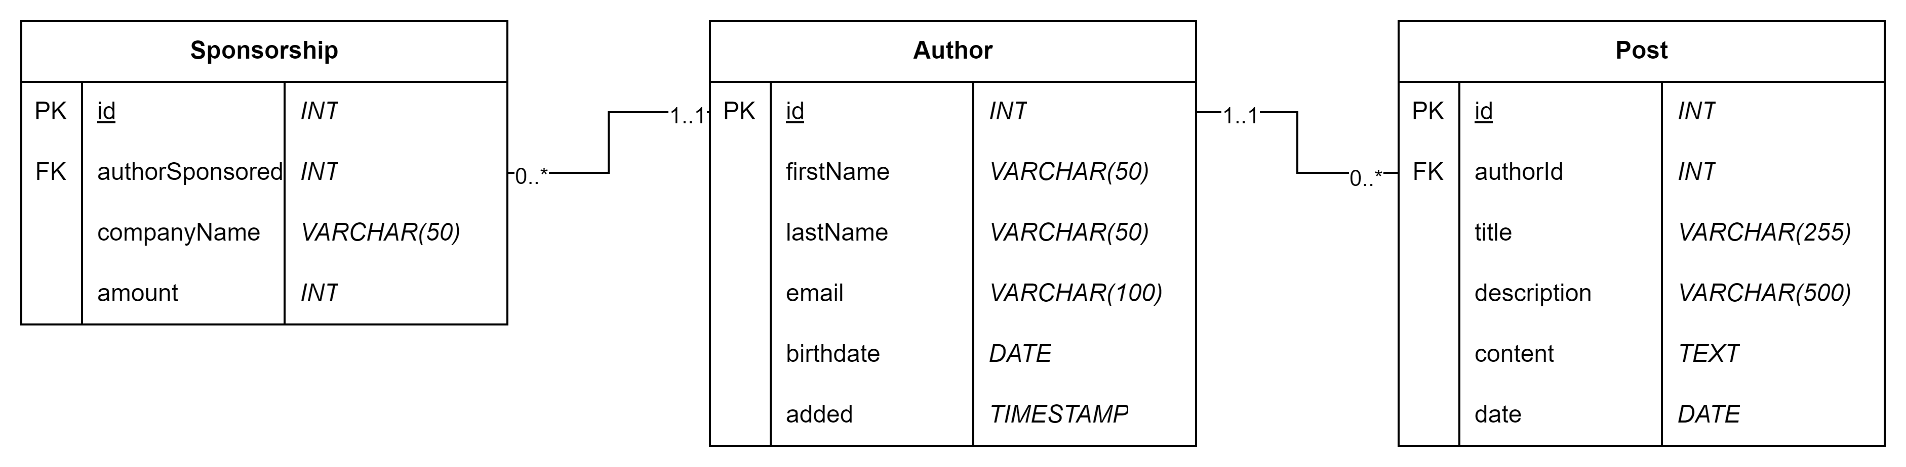
Try it out
Download/import the blog database
Solve all the blog_subquery.mysqlnotebook queries

